Slide 1
**Instructions for creating your employee PPE training presentation**
Slides # 10, 15, 19, 25, 29, 33, 39, and 42 must be filled in by YOU prior to training your employees. This information should be taken from your completed Hazard Assessments. You may add more bullets/slides for each PPE type if necessary.
You may delete sections of this training that do not apply to your work group. (For example, if no PPE is needed for Respiratory Protection, slides 40-42 can be deleted from the presentation.)
Slides 2-5, and 43-46 MAY NOT BE REMOVED.

Slide 2
The Basics of Personal Protective Equipment (PPE)
Created by Penn State University – Environmental, Health and Safety Department.

Slide 3
PPE Training
PPE
101
Personal Protective Equipment (PPE) is any safety equipment workers wear to prevent injury in the workplace when a hazard can not be eliminated.
Training is required by OSHA regulations contained in 29 CFR 1910.132 - .140 as well as by PSU policy.
At the completion of this training you will know:
  When PPE is necessary
  What PPE is necessary
  How to properly don, doff, adjust and wear PPE
  The limitations of PPE
  The proper care, maintenance, useful life, and disposal of the PPE

Slide 4
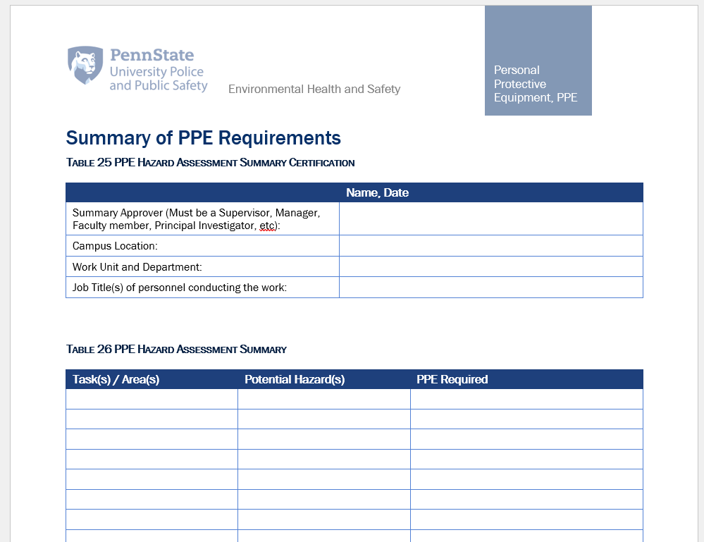
What is this training based on?
PPE
101
Designated individuals from your work group conducted a PPE hazard assessment based off the requirements of the PSU PPE Program to determine any and all jobs that would require the use of PPE.
This information was then consolidated into one document.

Slide 5

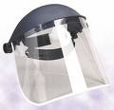
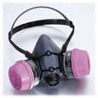
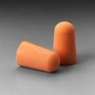


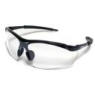

Common Types of PPE
Head
Eyes
Face
Hands
Feet
Body
Hearing
Respiratory

Slide 6
Head PPE
Needed when employees are exposed to hazards that have potential to cause a head injury.
Examples of hazards:
  Flying objects.
  Falling objects or materials.
  Working near exposed energized electrical equipment.
  Working around or on scaffolds.
  Working at construction sites.
  Working around overhead tools or machinery.

Slide 7

Types of Head Protection
Impact Protection
  Type I – Is designed to protect only against objects falling from straight overhead, hitting the hardhat on the top.
  Type II – Is designed to protect against impacts on the top of the head as well as on the sides.
Electrical
  Class G (General) protects up to 2,200 volts.
  Class E (Electrical) protects up to 20,000 volts.
  Class C (Conductive) offers no electrical protection.

Slide 8
Donning Head Protection
Hard hat protection is effective only if the hat is adjusted to fit properly and is worn squared and not cocked at an angle or perched on the back of the head.
Severe lacerations from relatively light blows have been incurred by workers wearing hard hats in unusual positions.
Must not be worn backwards.

Slide 9
Care and Maintenance
Check prior to each use for cracks, damaged suspension and chalky appearance (UV damage).
  Be aware that stickers placed on hardhat can conceal damage.
Replace as necessary.
Do not store in direct sunlight.

Slide 10
Specific Head PPE
Refer to Part C – PPE Summary for all situations when head protection is required.
Or give examples: ex) working in steam plant, cutting tree
Or Ex) When you will be (LIST JOB NAME), (LIST HEAD PPE TYPE FROM HAZARD ASSESSMENT) is to be worn at all times!

Slide 11
Eye PPE
Needed when an employee work presents the potential of causing eye injury from physical, chemical, or radiation agents.
Examples of hazards:
  Machines
  Lasers
  Impacts
  Heat
  Tools
  Flying Particles / Dust
  Electrical work
  Chemical handling

Slide 12
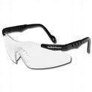
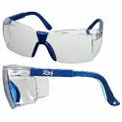

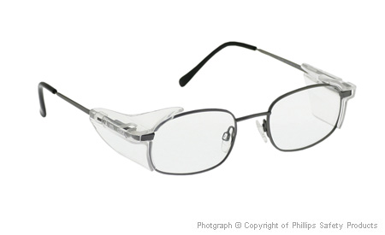
Types of Eye Protection
Non-Prescription safety glasses.
Prescription safety glasses.
  Employees that wear prescription (Rx) lenses can use non-prescription eye protection worn over prescription lenses as long as it does not compromise the fit of either piece of eyewear.
All eye protection must be ANSI Z87 approved.

Slide 13

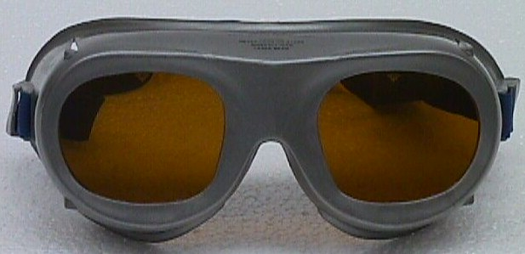
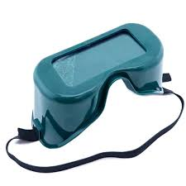
Types of Eye Protection
Goggles
  Chemical
  Laser
  Welding
Chemical goggles protect your eyes, eye sockets, and the facial area immediately surrounding the eyes from impact, dust, and splashes.
Chemical goggles are generally stronger than safety glasses and are used for higher impact, particle and chemical splash protection.
Laser and Welding goggles protect the eyes from harmful light.
All eye protection must be ANSI Z87 approved.

Slide 14
Care and Maintenance
Check prior to each use for cracks or damage.
Replace as necessary.
Store in a clean area.

Slide 15
Specific Eye PPE
Refer to Part C – PPE Summary for all situations when eye protection is required.
Or give examples: ex) working in steam plant, cutting tree
Or Ex) When you will be (LIST JOB NAME), (LIST EYE PPE TYPE FROM HAZARD ASSESSMENT) is to be worn at all times!

Slide 16
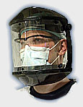
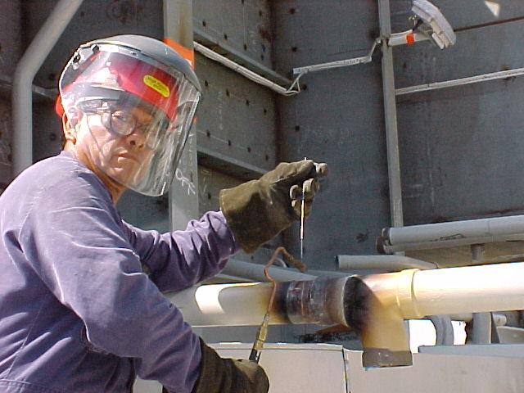
Face PPE
Needed when work presents the potential of causing facial injury from physical, chemical, or radiation agents.
Examples of hazards:
  Contents under pressure
  Splash hazard
  Flying objects / particles
  Electrical work

Slide 17
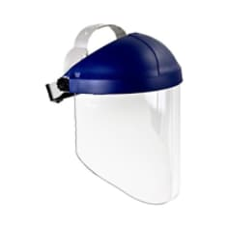

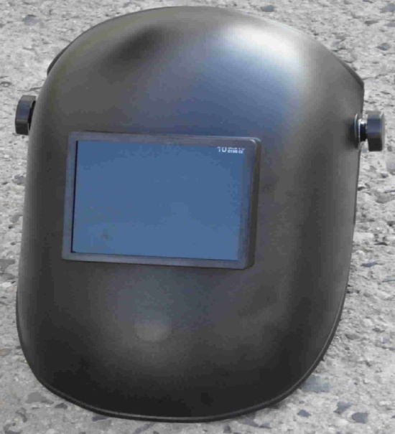
Types of Face Protection
Face Shield
Welding Shield

Slide 18

Donning Face PPE
Safety goggles or goggles must always be worn under a face shield.
Once goggles are in place, position face shield over face and secure on brow with headband.
Adjust to fit comfortably.

Slide 19
Specific Face PPE
Refer to Part C – PPE Summary for all situations when face protection is required.
Or give examples: ex) working in steam plant, cutting tree
Or Ex) When you will be (LIST JOB NAME), (LIST FACE PPE TYPE FROM HAZARD ASSESSMENT) is to be worn at all times!

Slide 20
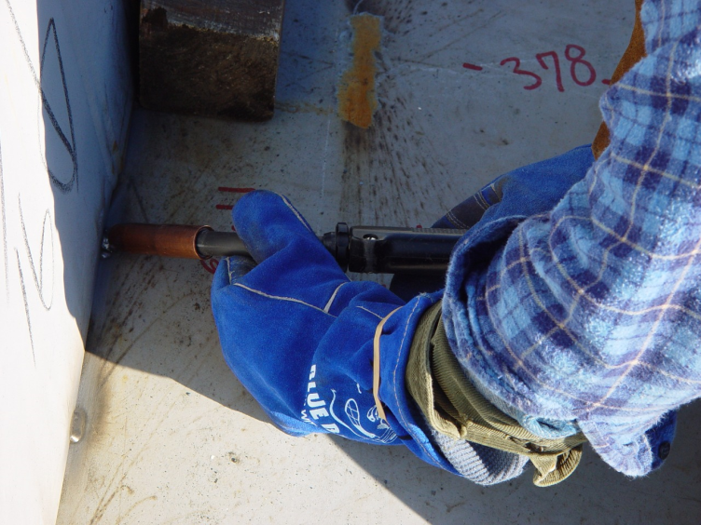
Hand PPE
Needed when work presents the potential of causing hand injury from physical, chemical, or radiation agents.
Examples of hazards:
  Absorbing harmful substances
  Sharp objects capable of causing cuts, abrasions, or punctures
  Chemical or thermal burns
  Electrical work
  High/Low temperatures

Slide 21



Types of Hand Protection
Chemical Resistant - Check SDS or product label.
Puncture / cut / abrasion Resistant
Those with a latex allergy can use vinyl, nitrile, etc. based on the compatibility charts or SDSs.

Slide 22
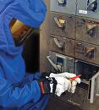

Types of Hand Protection
Voltage Rated
Temperature Resistant
Infectious Agent / Biohazard Resistant – Latex, Vinyl, Nitrile, etc.

Slide 23
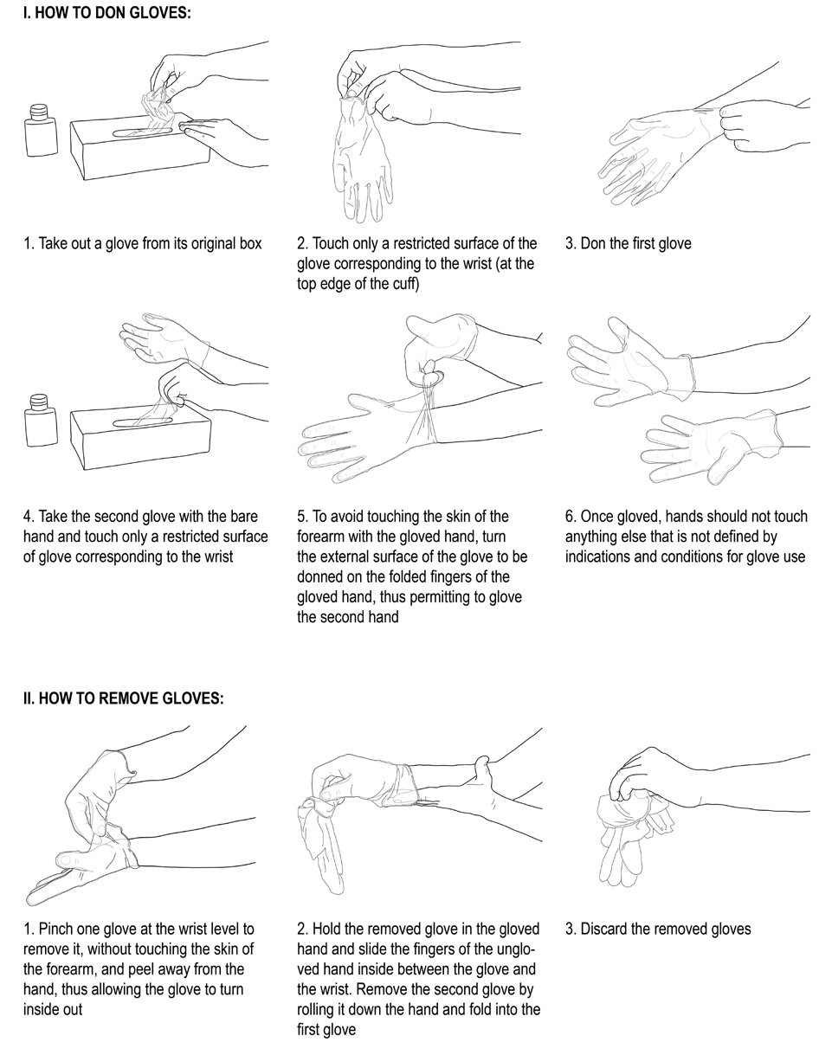
Glove Donning and Doffing
Image: World Health Organization

Slide 24
Care and Maintenance
Check prior to each use for cuts, cracks or discoloration.
Replace as necessary.
Discard single use gloves after use. (Latex, Nitrile, Vinyl, etc)
Store in a clean area.

Slide 25
Specific Hand PPE
Refer to Part C – PPE Summary for all situations when hand protection is required.
Or give examples: ex) working in steam plant, cutting tree
Or Ex) When you will be (LIST JOB NAME), (LIST HAND PPE TYPE FROM HAZARD ASSESSMENT) is to be worn at all times!

Slide 26
Feet PPE
Needed when work presents hazards that have potential to cause a foot injury.
Examples of hazards:
  Falling objects
  Rolling objects
  Piercing/cutting injuries
  Electrical work
  Chemical exposure

Slide 27

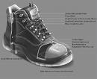
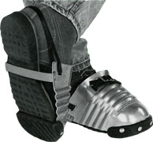
Types of Foot Protection
Steel/Composite toed - Must be ANSI Z41 or ASTM F2413 approved.
Electrical resistant – Will have the letters “EH” on the tongue.
Chemical resistant

Slide 28
Care and Maintenance
Check safety shoes prior to each use for cuts, cracks or other damage. Replace as necessary.
Keep electrical hazard shoes dry and free from conductive materials. Replace if sole is punctured, cut, or embedded with conductive materials.
Chemical resistant shoes should be replaced if they are discolored, disfigured, or exhibit any breaks, cracks, or other surface degradations.
Store all shoes in a clean, dry location.

Slide 29
Specific Foot PPE
Refer to Part C – PPE Summary for all situations when foot protection is required.
Or give examples: ex) working in steam plant, cutting tree
Or Ex) When you will be (LIST JOB NAME), (LIST FOOT PPE TYPE FROM HAZARD ASSESSMENT) is to be worn at all times!

Slide 30
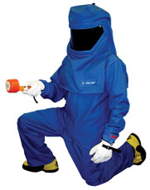
Body PPE
Needed when work presents a potential for contamination or injury to other parts of the body such as legs, arms, back, chest.
Examples of hazards:
  Heat
  Splashes
  Hot/cold metals and liquids
  Impacts
  Sharp objects
  Chemicals
  Electrical work
  Radiation

Slide 31


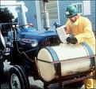

Types of Body Protection
  Lab coats
  Aprons
  Chemical resistant sleeves
  Tyvek suits
  Coveralls
  Arc Flash Rated

Slide 32
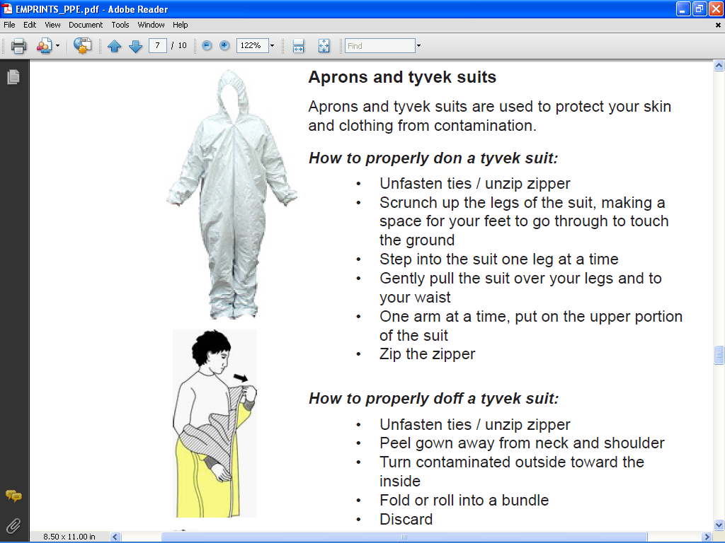
Body PPE Removal
  Tyvek suits
Image: University of Hawaii

Slide 33
Specific Body PPE
Refer to Part C – PPE Summary for all situations when body protection is required.
Or give examples: ex) working in steam plant, cutting tree
Or Ex) When you will be (LIST JOB NAME), (LIST BODY PPE TYPE FROM HAZARD ASSESSMENT) is to be worn at all times!

Slide 34
Hearing PPE
Needed when the average (over an 8 hour period) noise level of an area reaches 90 decibels.
  Hearing protection must be made available to employees when the average (over an 8 hour period) noise level reaches 85 decibels.
Examples of high noise areas can be:
  Mechanical rooms
  Shops
  Construction Sites
  When working with machinery/power tools
See PSU Hearing Conservation Program for requirements:
  Additional training is required to satisfy the program requirements.
  https://ehs.psu.edu/hearing-conservation/overview

Slide 35
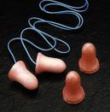

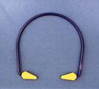
Types of Hearing Protection
Ear Plugs
Ear Muffs
Canal Caps

Slide 36

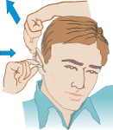

Donning Hearing Plugs
Follow manufacturers recommendations. The steps below is a commonly used method.
1. Roll the earplug up into a small, thin "snake" with your fingers. You can use one or both hands.
2. Pull the top of your ear up and back with your opposite hand to straighten out your ear canal. The rolled-up earplug should slide right in.
3. Hold the earplug in with your finger. Count to 20 or 30 out loud while waiting for the plug to expand and fill the ear canal. Your voice will sound muffled when the plug has made a good seal.

Slide 37
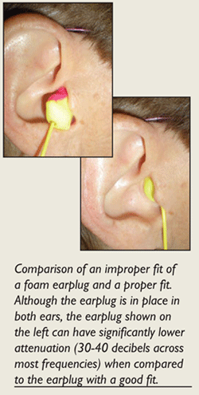
Ear Plug Fit Check
Check the fit. Most of the foam body of the earplug should be within the ear canal. Try cupping your hands tightly over your ears. If sounds are much more muffled with your hands in place, the earplug may not be sealing properly. Take the earplug out and try again.
ehstoday.com/images/PPE-fit.gif

Slide 38
Care and Maintenance
Check hearing protection for damage prior to each use for cuts, cracks or other damage. Replace if damage is found.
Store all hearing protection in a clean, dry location.
Replace disposable ear plugs frequently.

Slide 39
Specific Ear PPE
Refer to Part C – PPE Summary for all situations when hearing protection is required.
Or give examples: ex) working in steam plant, cutting tree
Or Ex) When you will be (LIST JOB NAME), (LIST HEARING PPE TYPE FROM HAZARD ASSESSMENT) is to be worn at all times!

Slide 40
Respiratory PPE
Needed when work presents an inhalation hazard.
Examples of hazards:
  Working with uncontained chemicals.
  Working with highly toxic chemicals.
  Working in dusty environment.
  Painting.
  Welding.
See PSU Respiratory Protection Program for requirements:
  Additional training is required to satisfy the program requirements.
  https://ehs.psu.edu/respiratory-protection/overview

Slide 41
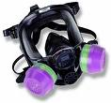

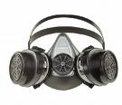
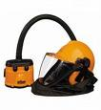
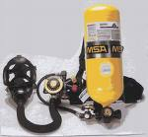
Types of Respiratory Protection
Dust Mask
½ mask
Full Mask
Powered Air Purifying respirator (PAPR)
Supplied Airline Respirator
Self Contained Breathing Apparatus (SCBA)

Slide 42
Specific Respiratory PPE
Refer to Part C – PPE Summary for all situations when respiratory protection is required.
Or give examples: ex) working in steam plant, cutting tree
Or Ex) When you will be (LIST JOB NAME), (LIST RESPIRATORY PPE TYPE FROM HAZARD ASSESSMENT) is to be worn at all times!

Slide 43
PPE Cleaning and Care
PPE must be kept clean and sanitary. Clean PPE with mild soap and water. Some PPE may require special cleaning, in these cases use the manufacturer’s recommendations.
If PPE is contaminated and cannot be decontaminated safely, it may need disposed of in a special manner to protect other employees from exposure to the hazard. EHS shall be contacted.
PPE shall be stored in such a way that it will not become contaminated such as plastic bags, lockers, closet, drawers.

Slide 44

PPE Maintenance and Repair
Do not use PPE if it is damaged and in need of repair.
It is the responsibility of the employee to make their supervisor aware as soon as PPE becomes damaged so that new PPE can be obtained.
Do not attempt to repair PPE.

Slide 45
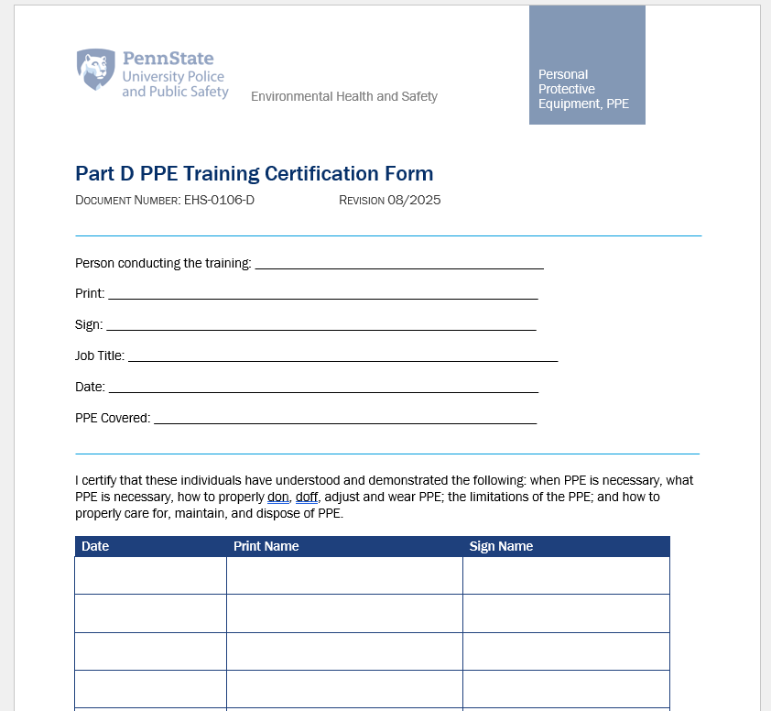
Completion of Training
If the following haven’t already been completed, please do them now.
  Hand out and/or review Part C – the summary of the PPE required for your work group.
  Document the training.

Slide 46
Additional Information
PSU PPE Program
  https://ehs.psu.edu/ppe/overview
EHS Department
  https://ehs.psu.edu/

