Slide 1
*Instructions for HazCom Work Group Specific Employee Training*
To fully meet the training requirements for Hazard Communication, you must add information to this PowerPoint presentation that is specific to your work group. Below are the instructions to help you properly fill out the following slides:
Slides # 7 - 23 must be filled in by you prior to training your employees.
You may add more information/slides for each topic as necessary.

Slide 2
*Instructions for HazCom Work Group Specific Employee Training*
You may not delete any slides. All slides must be reviewed with employees to comply with PSU Hazard Communication program and OSHA regulations.
The items found in RED font in any of the following slides are examples of the type of information that must be conveyed to employee. The items in RED font should be deleted and replaced with your work group’s specific information.
Keep an attendance roster for your records to document training by using Appendix B of the PSU Hazard Communication program.

Slide 3
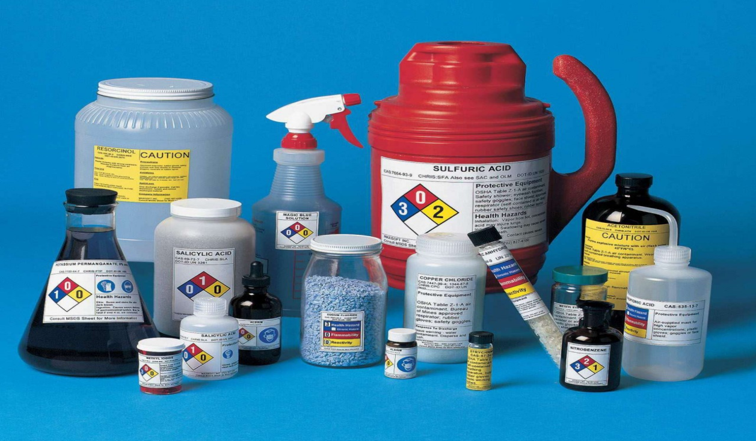
Hazard Communication (HazCom) – Work Group Specific Training

Slide 4
Overview
This training module is used to provide work group specific information pertaining to hazard communication topics as outlined in the PSU Hazard Communication program.
Training is required by Penn State University & OSHA regulations contained in 29 CFR 1910.1200.

Slide 5
Training Scope:
The location of the written PSU Hazard Communication Program and any work unit specific policies / procedures.
How to access the list of hazardous chemicals.
The location of hazardous chemicals.
How to access Safety Data Sheets (SDSs).
Labeling requirements.
The physical, health, simple asphyxiation, combustible dust, and pyrophoric gas hazards, as well as hazards not otherwise classified, of the chemicals in the work area.

Slide 6
Training Scope Continued
The proper handling, under all circumstances, of hazardous chemicals.
The required personal protective equipment (PPE) for chemicals.
The appropriate emergency procedures. (leaks/spills cleanup, exposures)
Work unit specific methods and observations used to detect the presence of hazardous chemicals. (Continuous monitoring devices, alarms, visual appearance, odors, etc)
Special hazards which may be encountered when performing non-routine duties in the course of work.

Slide 7
The location of the written PSU Hazard Communication Program and any work unit specific policies / procedures.
The location of the PSU written program can be found on the EHS website:
http://ehs.psu.edu/hazcom/requirements-guidelines
Example: Our work group has additional information pertaining to HazCom procedures which are documented and conveyed via this training program.
Example: Our work group has additional information pertaining to HazCom procedures which are found inside the 3-ring binder laying on the front desk of building ABC.

Slide 8
How to access the list of hazardous chemicals
Example: A hard copy of the list of hazardous chemicals used by our work group can be obtained by asking your supervisor.
Example: A hard copy of the list of hazardous chemicals used by our work group can be found in the maintenance shop posted beside the time clock.
Example: A hard copy of the list of hazardous chemicals used by our work group can be found in the main break room located in building ABC, room 123.

Slide 9
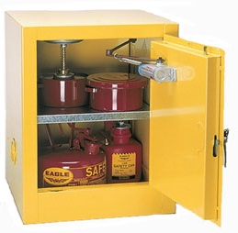
The location of hazardous chemicals
Example: Hazardous chemicals used by our work group can be found in the maintenance shop and every housekeeping supply closet.
Example: Hazardous chemicals used by our work group can be found in the basements of buildings ABC, DEF & GHI.

Slide 10
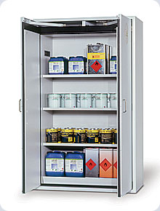
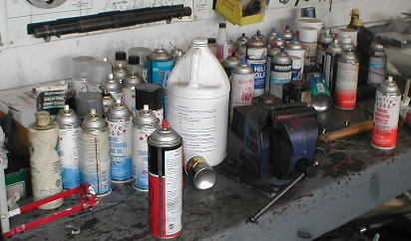
Which way is a better way to store Chemicals?
Notes:
Expectations of proper storage.
Picture on left is good. Everything is organized and orderly.
Picture on right is not good. No order, storage location is not good because it is on work surface.

Slide 11
How to access Safety Data Sheets (SDSs)
Example: SDS’s for our work group can be found in the 3-ring binder found at Mr. John Doe’s cubicle.
Example: SDS’s for our work group can be found in every housekeeping closet.
Examples: SDS’s for our work group can be obtained by using any computer in buildings ABC, DEF & GIH. User must login using password “ABC” and username “SDS”, click on the link titled “SDS”, then type the product name in the “SDS search” box.

Slide 12
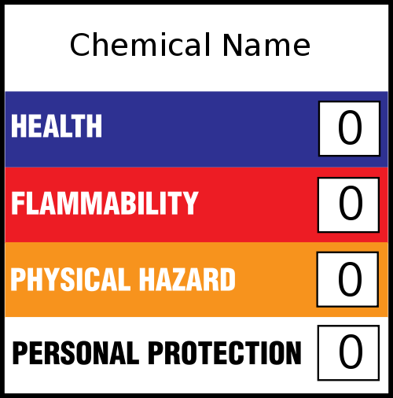
Labeling requirements for secondary containers
Secondary containers for chemicals used by our work group must be labeled with an HMIS label.
Convey any other work group specific labeling requirements here.

Slide 13
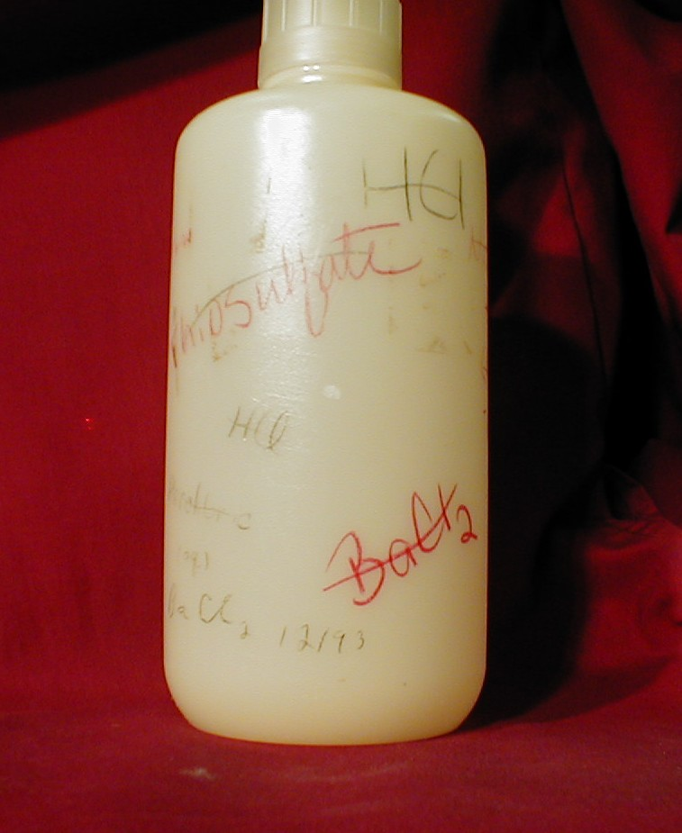
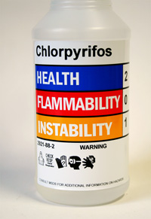
Which one is properly labeled?
Notes:
Expectations of labeling
Pic on left is bad. Multiple names of chemicals, no warning information
Pic on right is good. Full chemical name as well as legible and with warning information.

Slide 14
Potential Health Hazards
Health hazards for chemicals you use can be found by reading container labels or SDS’s.
EHS is available to help determine health hazards of chemicals.
As a training refresher from what was presented to you during General HazCom Training, these are the types of health hazards that you may come across:
Acutely toxic
Skin Corrosive or irritant
Eye damage or eye irritant
Respiratory or skin sensitization
Mutagen
Carcinogen
Reproductive toxicity
Specific target organ toxicity
Inhalation hazard
Hazard not otherwise classified (HNOC)
Notes:
Acutely toxic – adverse effects can occur from single exposure
Skin sensitization - substance that will induce an allergic response following skin contact
Mutagen - changes the genetic material, usually DNA
Hazard not otherwise classified (HNOC) - means an adverse physical or health effect identified through evaluation of scientific evidence during the classification process that does not meet the specified criteria for the physical and health hazard classes addressed in this section.

Slide 15
Potential Physical Hazards
Physical hazards for chemicals you use can be found by reading container labels or SDS’s.
EHS is available to help determine physical hazards of chemicals.
As a training refresher from what was presented to you during General HazCom Training, these are the types of physical hazards that you may come across:
Explosive
Flammable
Oxidizer
Self-reactive
Pyrophoric
Self-heating
Organic peroxide
Corrosive to metal
Gas under pressure
Contact with water emits flammable gas
Simple asphyxiant
Hazard not otherwise classified (HNOC)
Notes:
Oxidizer - substance that releases oxygen or another oxidizing material
Organic Peroxide - Organic peroxides can be severe fire and explosion hazards. Organic peroxide is fuel and oxidizer in one.
Hazard not otherwise classified (HNOC) - means an adverse physical or health effect identified through evaluation of scientific evidence during the classification process that does not meet the specified criteria for the physical and health hazard classes addressed in this section.

Slide 16
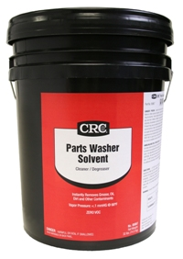
The proper handling, under all circumstances, of hazardous chemicals
The product label or SDS must be referenced to determine safe handling procedures of the chemical.
Example: do not use near open flame or energized equipment.
Example: provide ventilation.

Slide 17
The required personal protective equipment (PPE) for chemicals
Information regarding PPE is obtained from the work groups completed PPE Hazard Assessments and/or container label and/or SDS.
Example: CRC Knock’er Loose solvent requires nitrile gloves and safety glasses.
Example: CRC Parts washer solvent require nitrile gloves and safety glasses.
Example: All cleaning products require safety glasses

Slide 18
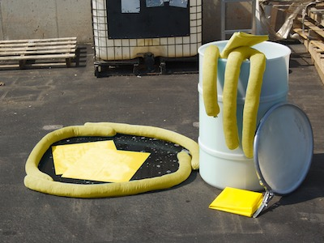
The appropriate emergency procedures -leaks/spills-
The following are general guidelines to be followed for a chemical spill/leak.
Inform your supervisor.
Immediately alert area occupants and evacuate the area, if necessary.
If possible find out what the chemical was.
If there is a fire or medical attention is needed, contact 911.
EHS is available to provide assistance.

Slide 19
The appropriate emergency procedures -spill/leak cleanup-
The following are general guidelines to be followed for a chemical spill/leak cleanup.
Make sure to identify material.
Wear PPE as referred by the SDS or other references for information.
Refer to SDS or other references for cleanup materials and disposal methods.
EHS is available for assistance.
Example – Convey any specific work group leak/spill cleanup procedures & exposure information
Example – Spill cleanup material is located outside room 2 in janitor closets.

Slide 20
The appropriate emergency procedures -chemical exposure/injury-
The following are general guidelines to be followed for a chemical exposure/injury.
Attend to any people who may be contaminated. Contaminated clothing must be removed immediately and the skin flushed with water for no less than fifteen minutes.
If you were exposed follow the first aid directions in the SDS and seek medical attention.
Call 911 if immediate medical attention is needed.

Slide 21
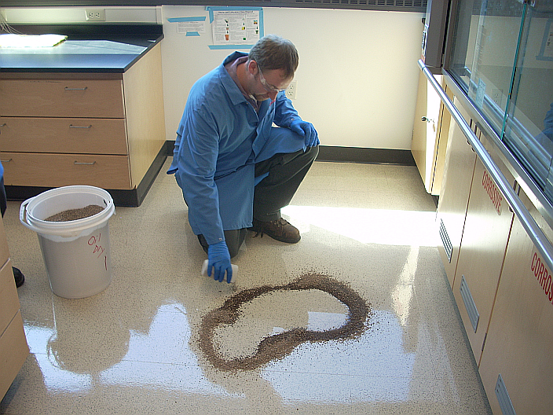
Correct Spill Control Yes or No
Notes:
Expectations of spill cleanup
1) Pic is good. Spill cleanup material present, dike formed, not stepping in spill, ppe on.

Slide 22
Work unit - specific methods and observations - used to detect the presence of a hazardous chemical release
Review any chemical monitoring devices used to detect releases.
Review any high hazard chemicals or an otherwise chemical of concern that the employees work with. Discuss visual appearance, odors and/or emissions such as smoke or clouds that occurs during a release.
Ex) Continuous monitoring devices for Carbon Dioxide are located in Room 1.
Ex) Red colored beacon lights are located in room 2.
Ex) Flashing white light and audible alarms will occur in Building 3.
Ex) Outside of a mechanical space in the basement is an oxygen sensor.
Ex) A special note about product YYY. There will be a odorless, yellow cloud hovering above the area if a leak has occurred.
Ex) A special note about product B. This compressed gas has a strong garlic odor.
Ex) If a slimy, purple substance is found in chemical storage closet 1 it is most likely a spill of product C. Because when Product C is spilled is creates a slimy, purple substance.

Slide 23
Special hazards which may be encountered when performing non-routine duties in the course of work
Non-routine duties refer to such tasks as hot work, permit required confined space entry, tasks only done a few times a year, chemicals used only a few times a year, tasks performed with only a certain type of chemical, etc.
Example – Follow hot work procedures before performing welding activities in Building Q. (Fire may occur)
Example – Follow Permit Required Confined Space entry procedures before cleaning tank 4. (Potential for explosive atmosphere and toxic atmosphere)
Example – Do not use Cleaner Y when performing the bi-annual cleaning of Equipment X, a reaction could occur so use Cleaner ABCD instead.
Example – when performing the annual cleaning of Equipment XYZ do not mix Cleaner A with Degreaser B because Hydrogen Gas will be released.
Example – Use only chemical TRS when performing the annual cleaning of machine Y because any other chemical used may react with the machine.
Example – Before opening chemical pipes to pipes must be traced to their to determine contents and process operators must be communicated with.

Slide 24
Additional Information
If there is a question about a chemical, contact your supervisor.
Refer to the PSU Hazard Communication program.
Contact PSU Environmental, Health and Safety 814-865-6391.

